Slide 1

HR & STRATEGIC DASHBOARD
Training and Development
Performance
Management
Workforce planning
Overview
HR
MISSION
VISION
OFFICIAL WEBSITE
STRATEGY
Company Overview & Performance
Competitors & Market Share
Global Locations & Impact
Comparison of Products & Services
Sales, Profit & Revenue
Annual Reports & User Manual

Slide 2
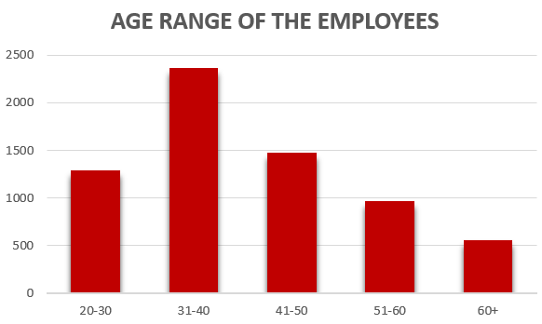
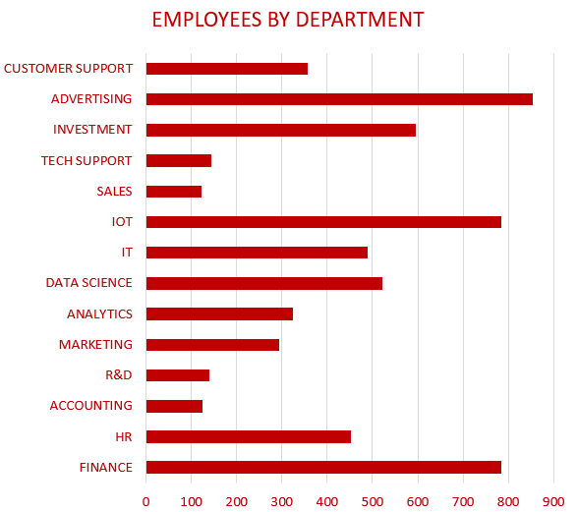
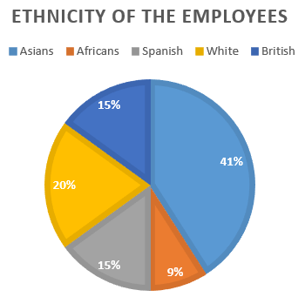
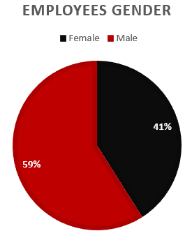
HR OVERVIEW
2012
2013
2014
2015
2016
2017
2018
2019
2020
2021

Slide 3
WORKFORCE PLANNING
2012
2013
2014
2015
2016
2017
2018
2019
2020
2021
NEW ROLES/ POSITIONS CREATED THIS YEAR
256
PERCENTAGE REDUCE IN EMPLOYEE SHORTAGE
4%
FEMALE EMPLOYEES HIRING INCREASED BY
6%
OPPORTUNITIES GIVEN TO EMPLOYEES WITH DIABILITY
46
AVERAGE INCREASE IN THE SALARY OF ALL DEPARTMENTS
13%
INCREASE IN PRODUCTIVITY/ PROFIT DUE TO NEW HIRES
1.2%

Slide 4
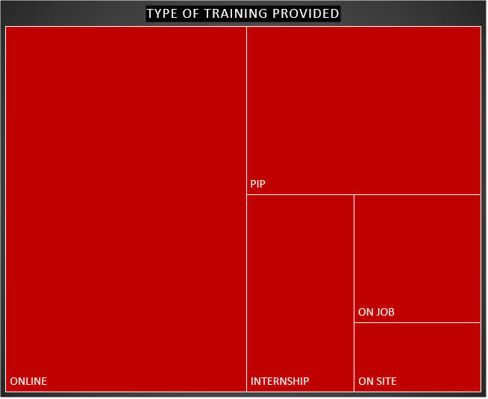
TRAINING & DEVELOPMENT
2012
2013
2014
2015
2016
2017
2018
2019
2020
2021
WORKSHOPS AND TRAINING PROGRAM CONDUCTED
78
COST SPENT PER EMPLOYEE
$124
INCREASE IN EMPLOYEE EFFICIENCY
6%
TOTAL MONEY SPENT ON EMPLOYEE TRAINING
$1.5 MILLION
EMPLOYEES WITH ATLEAST ONE PROFESSIONAL CERTIFICATION
2,254

Slide 5
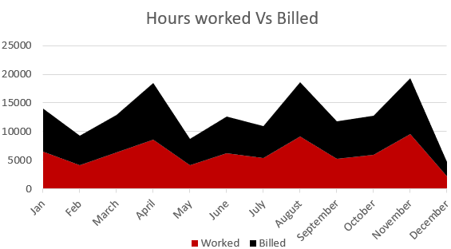
PERFORMANCE MANAGEMENT
2012
2013
2014
2015
2016
2017
2018
2019
2020
2021
AVERAGE SALARY OFFERED (PER YEAR) – ALL DEPARTMENTS
$65K
EFFECTIVE EMPLOYEE WORKING HOURS PER WEEK (INCLUDING BREAKS)
35
Average Employee Tenure
2.7 years

Slide 6

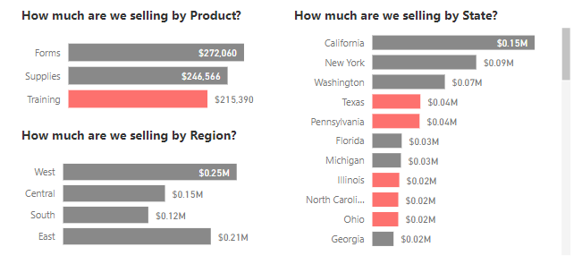
COMPANY OVERVIEW & PERFORMANCE
2012
2013
2014
2015
2016
2017
2018
2019
2020
2021
Red Hat Inc., is multinational software company that provides SaaS to many organizations.
It is currently a subsidiary of IBM.
Year of establishment - 1983
Head quarters – North Carolina
Founder – Bob Young
Revenue – 3.4 billion USD
CEO – Matt Hicks
Employees – Over 19,000

Slide 7
COMPETITORS & MARKET SHARE
2012
2013
2014
2015
2016
2017
2018
2019
2020
2021
CLICK TO DOWNLOAD SWOT ANALYSIS DOCUMENT
CLICK TO DOWNLOAD PESTEL ANALYSIS DOCUMENT
CLICK TO DOWNLOAD PORTER’S FORCES ANALYSIS DOCUMENT
CLICK TO DOWNLOAD COMPETITVE ADVANTAGE DOCUMENT

Slide 8
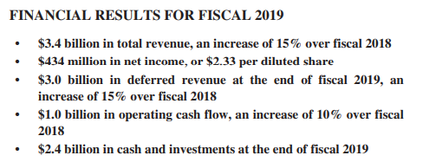
SALES, PROFIT & REVENUE
2012
2013
2014
2015
2016
2017
2018
2019
2020
2021

Slide 9
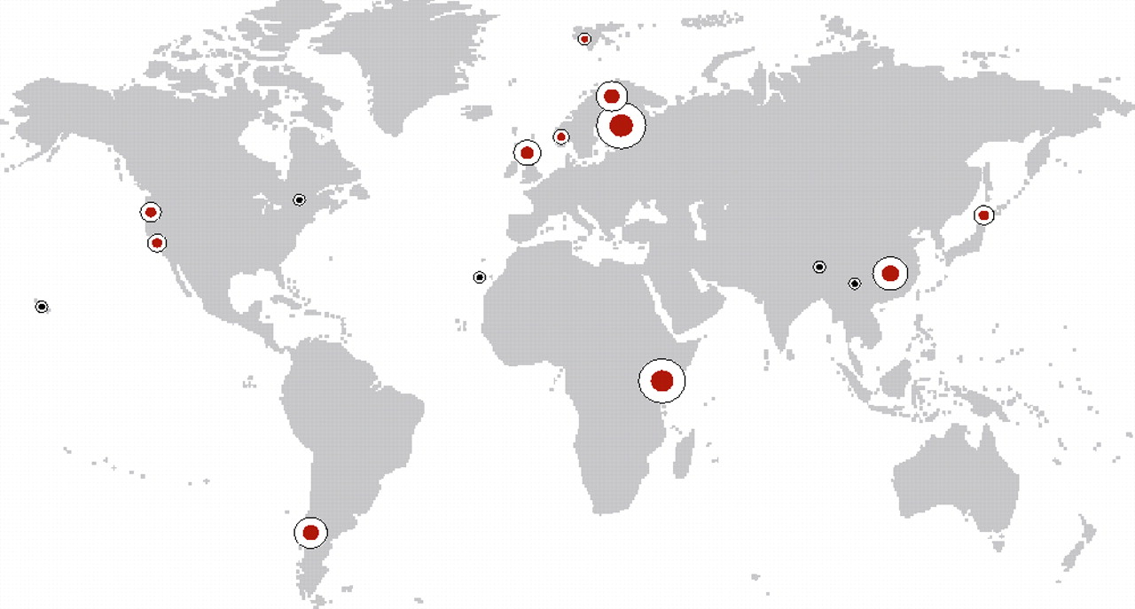
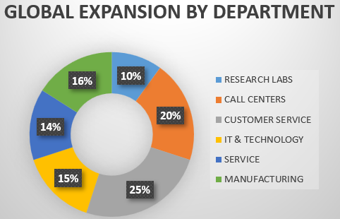
GLOBAL LOCATIONS AND IMPACT
2012
2013
2014
2015
2016
2017
2018
2019
2020
2021
RED HAT OFFICE LOCATIONS ACROSS THE WORLD
NUMBER OF NEW LOCATIONS COMPARED TO LAST YEAR
5
PROFIT GAINED IN THE NEW LOCATIONS ALONE IN THIS YEAR (MILLION)
$10.6

Slide 10
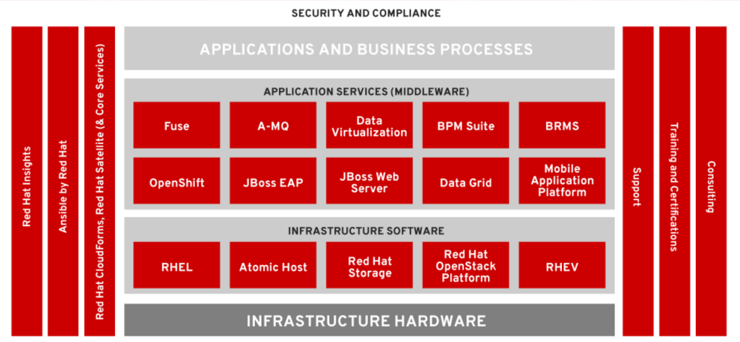
PRODUCTS & SERVICES

Slide 11


ANNUAL REPORTS & USER MANUAL
2012
2013
2014
2015
2016
2017
2018
2019
2020
2021
Click on the required document to DOWNLOAD

